Slide 3
HIDDEN PICTURES

Slide 4
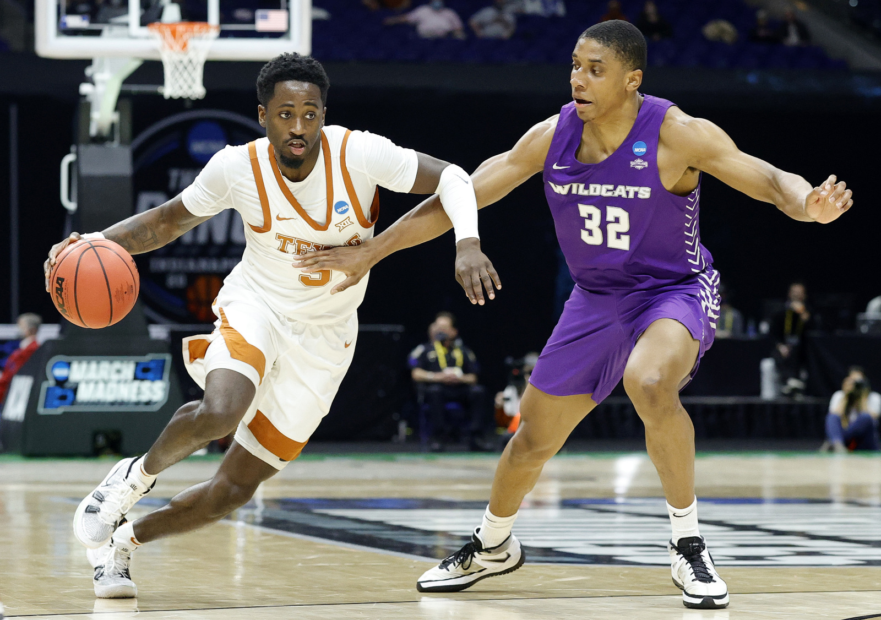
basketball

Slide 5
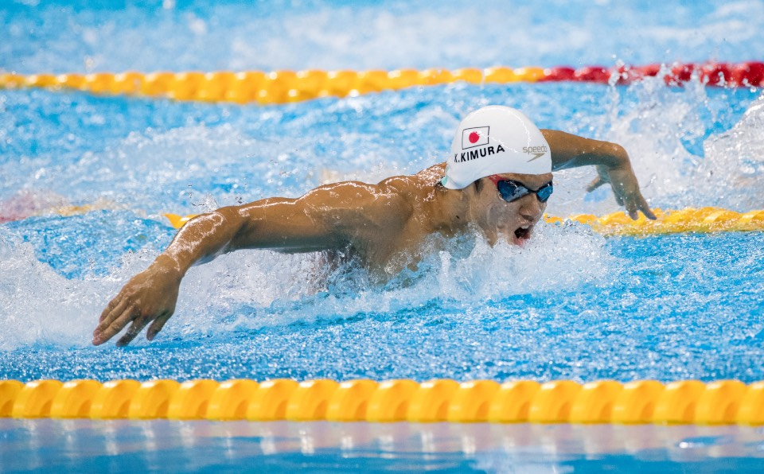
swimming

Slide 6
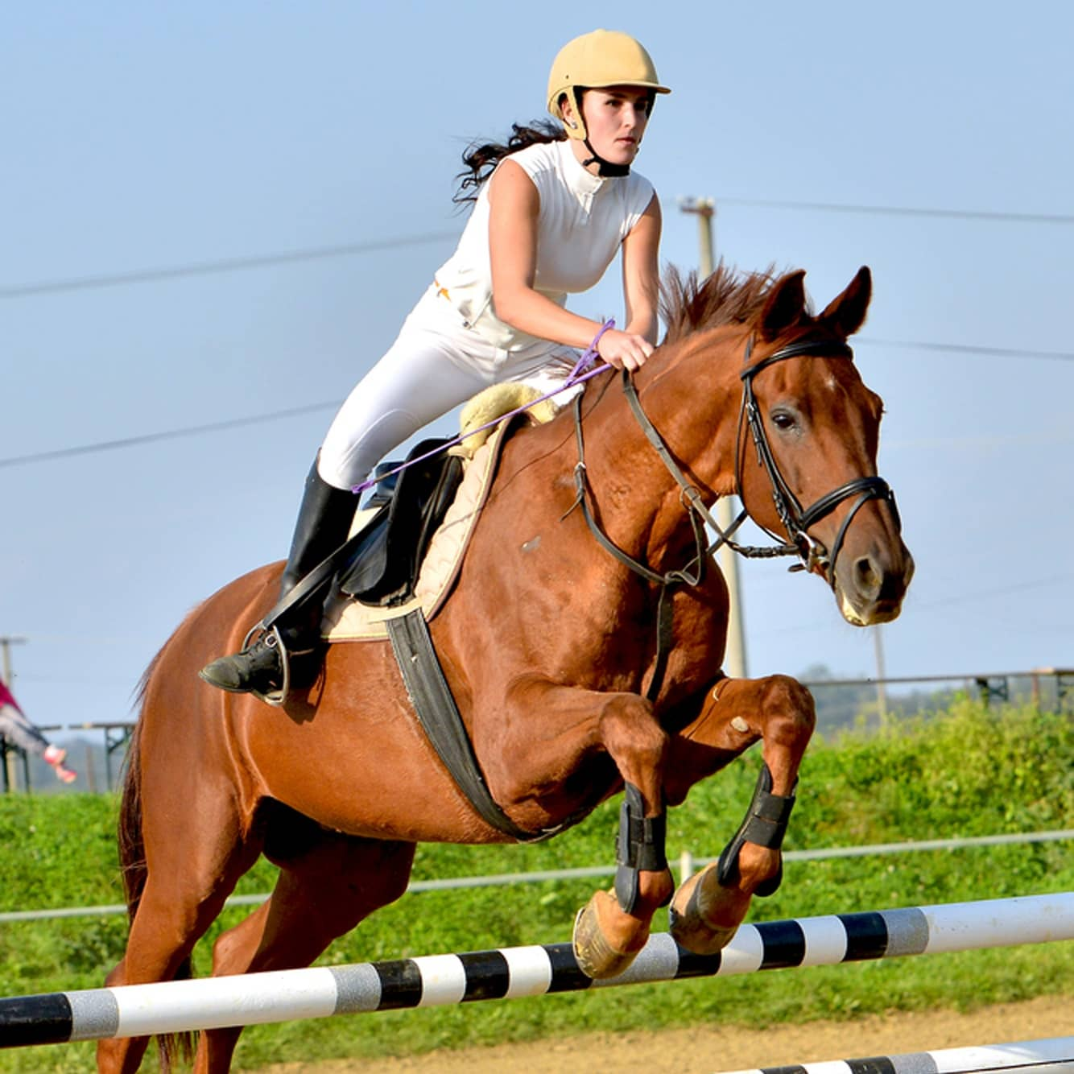
horse - riding

Slide 7
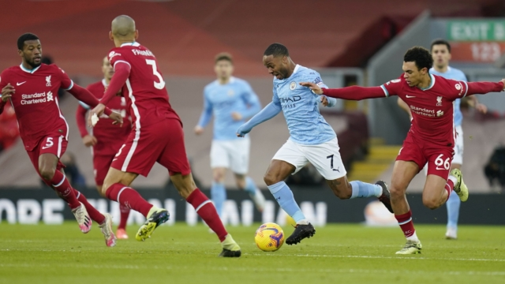
football / soccer

Slide 8
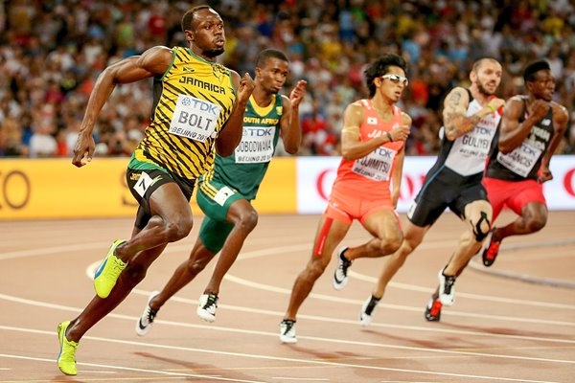
athletics

Slide 9
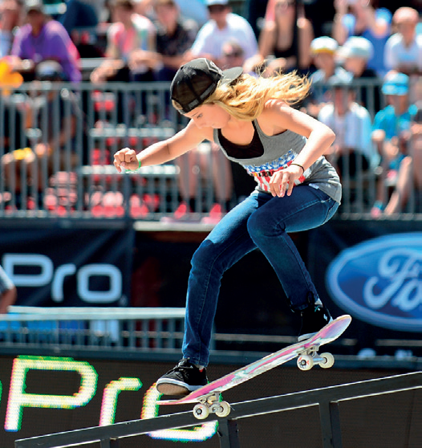
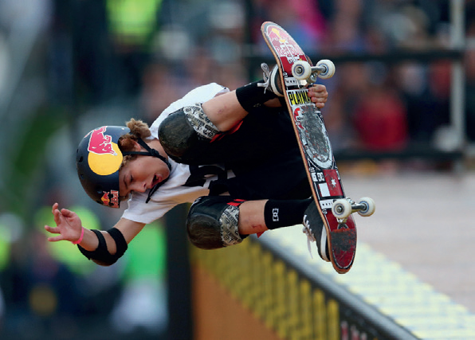
Alana
Tom

Slide 10
What can you remember about Alana and Tom?

Slide 11
UNIT 6
SPORTS
Lesson 5: language focus

Slide 12
have got
1) Regular verbs _____________ past simple forms ending in -ed.
haven’t got
2) Irregular verbs ______________ past simple forms ending in -ed.
have got
3) Verbs in the past simple ___________ the same form for I, you, he, she, it, we and they.

Slide 14
* SIMPLE PAST TENSE – AFFIRMATIVE : thì Quá Khứ đơn (thể khẳng định)
1. Usage:
Thì quá khứ đơn diễn tả hành động xảy ra trong quá khứ.
Ordinary verb
Regular verb (V_{ed})
Irregular verb (V₂)

Slide 15
Regular verb (Ved)
Hầu hết các động từ , chúng ta thêm -ed vào sau động từ .
Ex: play → played
start → started
call → called
Với những động từ tận cùng là chữ -e, chúng ta chỉ thêm -d.
Ex: like → liked
compete → competed

Slide 16
2. FORM:
S + V_{2/ED} + O
Ex: I talked to him yesterday.
Ex: She went to the zoo 2 days ago.

Slide 17
3. Dấu hiệu nhận biết
- Yesterday : ngày hôm qua
- Ago : cách đây
- Last ( week, month, year): tuần vừa qua, …
- In + time ( trong quá khứ ): in 2020
- From time+ to time ( thời gian trong QK)
Ex: from 2020 to 2021

Slide 19
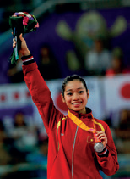
Complete the YOUNG SPORTS SUPERSTARS text with the past simple form of the verbs in blue
Phan Thị Hà Thanh (1) (start) ___________ gymnastics when she was six. She (2) (go) __________ to an athletic training centre in Hải Phòng. In 2011, she was the first Vietnamese gymnast who (3) (win) _________ a world medal for Việt Nam and she (4) (compete) ____________ in the Olympic Games in 2012 and 2016.
started
went
won
competed

Slide 20
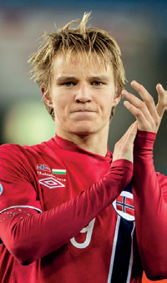
Martin Odegaard, from Norway, (5) (become) ___________ a professional footballer at fifteen and (6) (score) ____________ great goals for his club. He first (7) (play) ___________ international football before he was sixteen. A lot of famous clubs were interested in him and he (8) (train) ____________ with some of them. Finally, in 2015, Real Madrid (9) (give) ___________ him a contract.
became
scored
played
trained
gave

Slide 22
Listen and repeat the words
1) /t/: practised, watched 2) /d/: travelled, played 3) /ɪd/: started, decided

Slide 23
PRONUNCIATION “-ED”: cách phát âm “ed”
1. /id/: tận cùng là : /t, d/
Ex: wanted, ended, competed , visited
2. /t/: / k, p, gh (f), ch (ʧ ), s, sh(ʃ),c , ph, x /
Ex: talked, watched, brushed
3. /d/: những âm còn lại ( y, l, n, m, I, b, r, v….)
Ex: lived, played, cleared

Slide 24
Which letters come before the -ed ending in list 3?
‘t’ and ‘d’

Slide 25
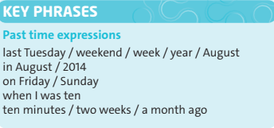
Read the Key Phrases

Slide 26
Look at the examples and answer the questions
He first competed when he was twelve. She last competed in 1981. He was on this programme two years ago.
1) How do you say the words in blue in your language? 2) Do we put “ago” before or after a past time expression?
after

Slide 27
Write sentences using the past simple and the Key Phrases. Then compare with other people in the class. Are any of your sentences the same?
I first (watch) the Olympics …
I last (do) my English homework …
I first (come) to this school …
I first (swim) in a pool …
I last (see) a good film …

Slide 28
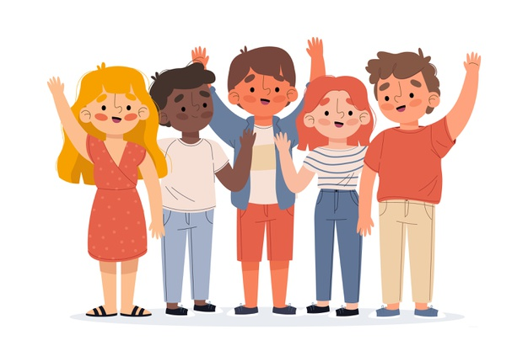
HOW POPULAR ARE YOU?

Slide 29
Write true and false statements about your life. Use the verbs on this page.
Example sentences:
I went to shopping center last month.
I studied English when I was 6.

Slide 30
Homework
- Learn by heart all structures.
- Workbook: Exercises on page 45.
- Prepare the next lesson: SPEAKING

Slide 31
www.phuongnam.edu.vn

Slide 32
Thank you!
CTCP ĐẦU TƯ VÀ PHÁT TRIỂN GIÁO DỤC PHƯƠNG NAM

